Slide 1
BEADITUP.JA
PROJECT PROPOSAL

Slide 2
TABLE OF CONTENTS
01
02
03
04
BACKGROUND
CHALLENGE
PRODUCT FUNCTIONALITY
STAKEHOLDERS
General overview of the organization
Need for services based on how things are currently done
Persons who have potential benefit from or impact on the project
Main features to be included in the software

Slide 3
BACKGROUND
01
General overview of the organization

Slide 4
ABOUT BEADITUP.JA
BEADITUP JA is an internet-based small business.
It was established in 2020 to provide homemade beaded bracelets to customers.
This business operates on the social media platforms of instagram and twitter
The company primarily targets young adults and offers delivery services

Slide 5
ABOUT BEADITUP.JA
The owner of this business is Akil Williams, a student entrepreneur and the sole proprietor who built the business out of his passion for jewellery.
He is responsible for recording orders and keeping track of his inventory in order to supply those customer orders.
He is also the only employee and must perform all the administrative, production and delivery tasks.

Slide 6
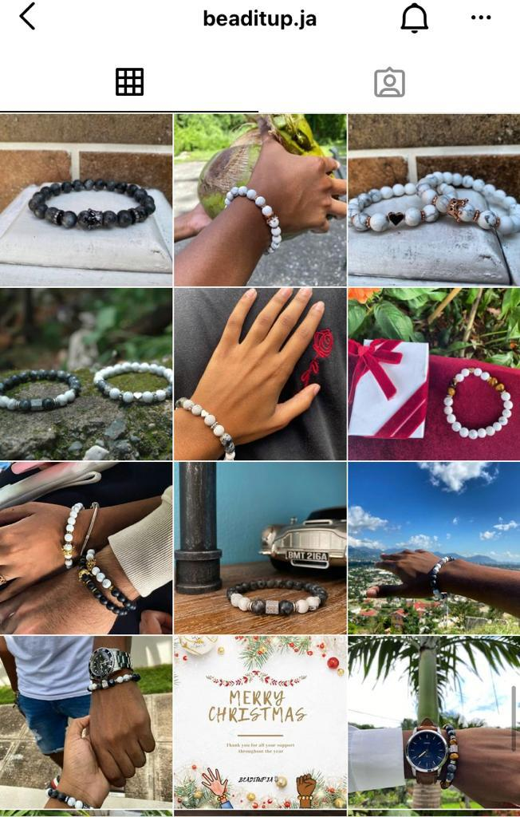
A GLIMPSE OF BEADITUPJA’S INSTAGRAM BUSINESS PAGE

Slide 7
CHALLENGE
02
Need for services based on how things are currently done

Slide 8
THE PROBLEM/NEED
This software would help to manage the processes involved in Beaditup.ja’s Inventory and Order Management System.

Slide 9
PRODUCT FUNCTIONALITY
03
Main features to be included in the software.

Slide 10
MAIN FEATURES
Features include:
- tracking and updating inventory
- storing product details
- display products to customers
- receiving and tracking customer orders
website/app
- estimating possible stock
customer/owner
Notes:
In order to achieve greater efficiency, the client has highlighted a few high level key features that he requires the system to have.
The following are the features we are considering to make up the scope of the project with regards to schedule constraints and the current skill level of the development team:

Slide 11
THE PROBLEM/NEED
Due to all processes of manufacturing, order management and delivery being manually handled by one person, there is inefficiency in keeping track of stock, filling orders and getting deliveries done.
Beaditup.ja would like a software solution to replace or automate the manual processes.

Slide 12
STAKEHOLDERS
04
Persons who have potential benefit from or impact on the project

Slide 13
STAKEHOLDERS
BUSINESS OWNER - Responsible for all the business administration manufacturing and delivery processes/tasks.
CUSTOMER - Purchases or make an orders from the business, via Instagram, Twitter or website for products.

Slide 14
STAKEHOLDERS
SUPPLIERS - Provides material to be purchased by the business in order to produce the bracelets.
DEVELOPERS- Developers have the opportunity to learn how to design and implement usable software to tackle a real business problem.

Slide 15
THANKS!
Any questions?

